Slide 1

Premium Travel
Luxury Travel Made Simple

Slide 2

OOAD Perspective of Premium Project

Slide 3
Tech Stack, Information and Specifications
Team Members: Hayley Rymer and Teme Woldesenbet
Language: Java
Integrated Development Environment: IntelliJ IDEA
Diagram Tools: Lucidchart and Visio
Communication: GroupMe
Repository: GitHub
Other Tools: Microsoft PowerPoint and Word

Slide 4
Progression is Key…
The next view slides demonstration the progression of diagrams as the team’s understanding of relationships between Object Oriented Programming increased.
01
Just like an outline is essential for writing a paper, creating appropriate diagrams show a snapshot of what the source code should be doing at a given time.
02
Diagrams can require more than one version. By keeping them neat and organized, it is easy to add, modify, or delete instances or other notations like inheritance require by object diagrams.
03

Slide 5
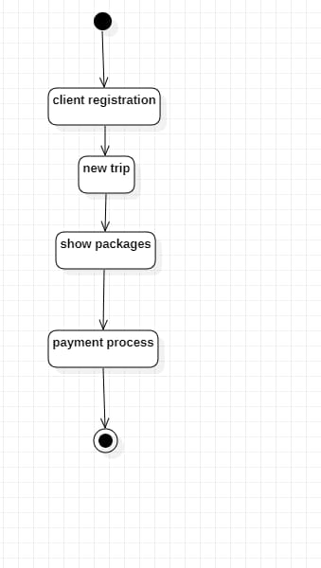
Iteration 1: Example of initial state diagram

Slide 6
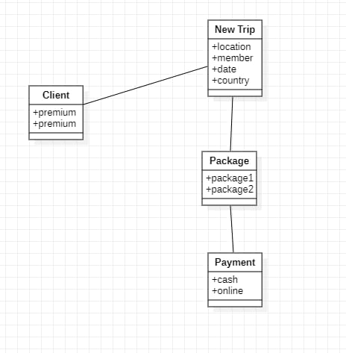
Iteration 1: Another example of initial class diagram

Slide 7
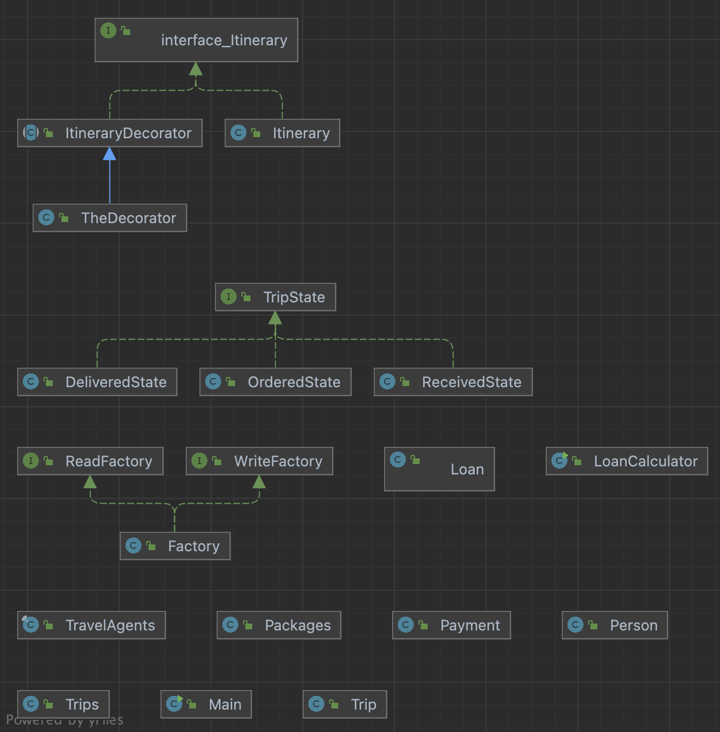
UML Diagrams
UML Diagram with methods, fields, constructors, and dependencies to help show relationships
Helps show orientation and structure for code.
To the left is an example of initial UML diagram

